Slide 1




Project Dashboard
01
There is always need to add text in shapes somewhere
CHANGE ON A PAGE
02
There is always need to add text in shapes somewhere
Triangles are a good indication of a risk
Triangles are a good indication of a risk
Triangles are a good indication of a risk
BUDGET SECTION
HEADING
HEADING
012345678
Something team or staff related goes in here – high level
Something team or staff related goes in here – high level
Use this segment to call out something financial –better in text than in a chart.
An indication that costs went down and it was good
HEADING
HEADING
STORY OF
THE TEAM
Something team or staff related goes in here – high level
Something team or staff related goes in here – high level
Charts are editable in Excel. Double Click to modify. Keep them simple, remove anything not essential.
$250K
Another line here – space
Another line
01
PLAN
02
PLAN
03
PLAN
04
PLAN
58%
40%
This area is perfect for a process or some steps that need to be followed in order. They’re numbered to show that.
This area is perfect for a process or some steps that need to be followed in order. They’re numbered to show that.
This area is perfect for a process or some steps that need to be followed in order. They’re numbered to show that.
This area is perfect for a process or some steps that need to be followed in order. They’re numbered to show that.
Use one pie chart for each stat, rather an one for all
Use one pie chart for each stat, rather an one for all
JANUARY
FEBRUARY
APRIL
AUGUST

Slide 2







Make sure it’s really clear which bit of this pie chart is important. Give a percentage or use a bolder colour.
Note about this part here
80%
Project Dashboard
65%
CHANGE ON A PAGE
80% of little people are always good to show for stats involving people
50%
GEOGRAPHICAL RELEASE
80%
Say something about here
Say something about here
COHORT
COHORT
Say something about here
Something journey or data related goes in here – high level
Something journey or data related goes in here – high level
Something journey or data related goes in here – high level
Note about a segment of your audience, could be gender or role
Note about a segment of your audience, could be gender or role
TIMELINE
$250K
Notes about a milestone or deliverable
Notes about a milestone or deliverable
Notes about a milestone or deliverable
Notes about a milestone or deliverable
19
JAN
MAR
MAY
JUL
Sometimes a big number is all you need to show.
JULY
8 DAYS
GO LIVE
FEB
APR
JUN
Sometimes a big number is all you need to show.
Significant date or countdown timer goes in here
Notes about a milestone or deliverable
Notes about a milestone or deliverable
Notes about a milestone or deliverable

Slide 3





1
2
3
Project Dashboard
Notes about a milestone or deliverable or an important sequential step in the journey
Notes about a milestone or deliverable or an important sequential step in the journey
Notes about a milestone or deliverable or an important sequential step in the journey
CHANGE ON A PAGE
IN A RECENT SURVEY
PROCESS STEPS
Notes about a milestone or deliverable or an important sequential step
1
1
2
3
4
Notes about a milestone or deliverable or an important sequential step
ACTIVITY
ACTIVITY
ACTIVITY
ACTIVITY
2
4/5
80% of little people are always good to show for stats involving people. The number of people is not important if you are showing a percentage
8
7
6
5
Notes about a milestone or deliverable or an important sequential step
ACTIVITY
ACTIVITY
ACTIVITY
ACTIVITY
3
$250K
When the chart is not very self explanatory always call out what you want them to see
63%
This could be a quote or a concern related to a percentage – it probably important to get the big boxes
Notes about a milestone or deliverable or an important sequential step
4
Notes about a milestone or deliverable or an important sequential step
24%
This could be a quote or a concern related to a percentage – it probably important to get the big boxes
24%
5

Slide 4





CHANGE IMPACT ON A PAGE
Jun
Jul
Aug
Sep
Oct
Nov
Dec
What is happening to who at this stage in the timeline?
What is happening to who at this stage in the timeline?
What is happening to who at this stage in the timeline?
What is happening to who at this stage in the timeline?
What is happening to who at this stage in the timeline?
What is happening to who at this stage in the timeline?
What is happening to who at this stage in the timeline?
Add a short description of the page in here and the purpose of this one page. Talk about the stakeholder engagement you have done already.
25%
80%
If you have any support from your business units you could add this in here. It will help to support the project and manage resistance.
Impacted Headcount
Impacted Technology
25% of employees will be impacted, although the change will be minimal
80% of SOPS need to be updated to reflect interface changes
27
Change
Champions
10%
30%
Add in any financials or additional secondment resources here.
Impacted Processes
Impacted People
Where will they come from, how will their KPIs reflect the work
Only 10% of processes will be impacted by the change
27 New FTE will be required to support the changes
Add in any financials or additional secondment resources here.
984
Department Name
Leader Impact & Support
8
Extra
Support Staff
This could be the training required and the options available for the training
124
Department Name
OPTION A
124
Remember to include the impact on leaders and your sponsor. Is there any additional time required from them to lead and support your change?
What about after Go-Live?
A
Department Name
Talk about this training or communications option here
124
Don’t forget to talk about any additional impact supporting your change when it goes live, and additional support or resources that may be required when you hand it over to BAU.
Department Name
OPTION B
B
124
Estimated extra time for leaders in the next 4 months
Talk about this training or communications option here
Department Name
124

Slide 5







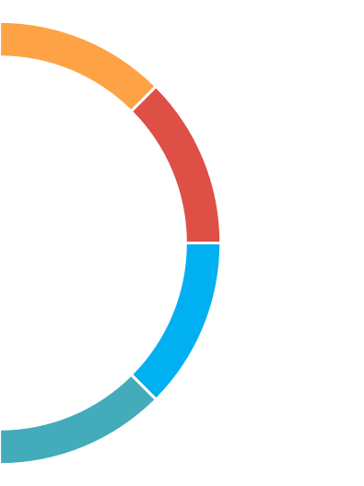









Most Change Managers have many years experience in business
70%
30%
10%
Age
<20
850
950
20%
750
1100
Most change managers are female
Where are all the men in Change Management?
20-30
950
35%
800
800
30-40
Average Contractor
DAILY RATE
5 Year trend
15%
Change Management is predominantly CONTRACTOR BASED
40-50
20%
50+
2 out of 10
70%
17%
13%
Change Management shows no sign of agism with many experienced female change professionals in director positions
HR
Recruitment or organisational HR, often a coaching or mentoring role
CONTRACTOR
FIXED TERM
PERMANENT
Have a recognised Professional Change Qualification and over 70% of those qualified hold the PROSCI certification
Change is often delivered within a project so the CM requirement is short term, with only larger organisations retraining permanent Change Managers
TRAINING
Training delivery or an instructional design role
What did Change Managers do before they became Change Managers?
PROSCI
PROJECT
70%
People centric PMs switch to change or combine the two
Westpac is the largest employer of CMs
MBA
BUSINESS ANALYSTS
BA’s and CM roles have overlap
OTHER
What industries employ Change Managers in NWS?

Slide 6













PROJECT NAME SATISFACTION PULSE CHEK
221
What were you surveying them about?
85%
45
Item one that we were asking them to comment on.
86% would repurchase or recommend to a friend
How many respondents were there? Any segments, mention 110 from X 220 from Y.
Over 175 respondents expressed satisfaction with X and reported they agree with Y
Top level observation about the satisfaction of the product or service
High level details of the next thing we were asking their option on..
DELIGHT
Results collected from participants who rated their satisfaction as high or very high.
We surveyed our audience and report on the
factor
64%
44%
77%
68%
62%
What made the audience jump for joy. Combine high and very high scores for more impact on a small sample
Found the content good or very engaging
Enter the summary of the question answered.
Enter the summary of the question answered.
Enter the summary of the question answered.
Enter the summary of the question answered.
Participant Comments
Customer comment goes in here
Customer comment goes in here
Amazing service
Customer comment goes in here
Customer comment goes in here
Customer comment goes in here
Any high level recommendations or insights at this stage?
Any high level recommendations or insights at this stage? Where can they find the full report or additional findings?
Recommendations

Slide 7







Dashboard Heading
30%
Heading for this element goes in here
50%
80%
Use the crop tool to extend or retract the darker shade of these little people
60%
Some text to explain what this demographic represents goes in here
Some text to explain what this demographic represents goes in here
compelling
80%
70%
INFORMATION
Some text to explain what this demographic represents goes in here
An explanation, call our or quote could go in here
Some text to explain what this demographic represents goes in here
Heading for this chart goes in here
Some quote text to explain what this demographic represents goes in here
Some quote text to explain what this demographic represents goes in here
Some text to explain what this demographic represents
Some text to explain what this demographic represents goes in here
What does this measurement mean
The numbers and categories for this chart can be changed by selecting the chart and choosing edit chart
What does this measurement mean

Slide 8





STAKEHOLDER IMPACT
STAKEHOLDER GROUP
25%
Details about this stage of the project go in here. There is space for a few lines of text
275
PROCESSES IMPACTED
TRAINING REQUIRED
IMPACTED
STAKEHOLDER GROUP
65%
Details about this stage of the project go in here. There is space for a few lines of text
180
PROCESSES IMPACTED
TRAINING REQUIRED
IMPACTED
STAKEHOLDER GROUP
40%
Details about this stage of the project go in here. There is space for a few lines of text
375
PROCESSES IMPACTED
TRAINING REQUIRED
IMPACTED
STAKEHOLDER GROUP
25%
Details about this stage of the project go in here. There is space for a few lines of text
25
PROCESSES IMPACTED
TRAINING REQUIRED
IMPACTED

Slide 9





DATE UP HERE
CHANGE PROGRAM PROGRESS UPDATE
Any important high level message could go on here – on track – on budget etc
01
02
03
04
PLANNED ACTIVITY
04
AUGUST
Details about the activities plan to do here.
WHAT WE DID
WHAT WE DID
WHAT WE DID
WHAT WE DID
Details about the change activities we took go here.
Details about the change activities we took go here. Details about the change activities we took go here
Details about the change activities we took go here.
Details about the change activities we took go here. Details about the change activities we took go here
Details about the change activities we took go here.
Details about the change activities we took go here. Details about the change activities we took go here
Details about the change activities we took go here.
Details about the change activities we took go here. Details about the change activities we took go here
PLANNED ACTIVITY
04
AUGUST
Details about the activities plan to do here.
PLANNED ACTIVITY
04
AUGUST
Details about the activities plan to do here.
A nice quote from some of your impacted stakeholders or sponsor
Is there anything that might not go to plan, call it out here
”
“
A nice quote from some of your impacted stakeholders or sponsor
Is there anything that might not go to plan, call it out here
7/10
Some type of success metric. Who turned up, what percentage of the audience have you engaged? What was the feedback?
RISKS

Slide 10
CHANGE IMPACT ON A PAGE
Jun
Jul
Aug
Sep
Oct
Nov
Dec
What is happening to who at this stage in the timeline?
What is happening to who at this stage in the timeline?
What is happening to who at this stage in the timeline?
What is happening to who at this stage in the timeline?
What is happening to who at this stage in the timeline?
What is happening to who at this stage in the timeline?
What is happening to who at this stage in the timeline?
Add a short description of the page in here and the purpose of this one page. Talk about the stakeholder engagement you have done already.
25%
80%
If you have any support from your business units you could add this in here. It will help to support the project and manage resistance.
Impacted Headcount
Impacted Technology
25% of employees will be impacted, although the change will be minimal
80% of SOPS need to be updated to reflect interface changes
27
Change
Champions
10%
30%
Add in any financials or additional secondment resources here.
Impacted Processes
Impacted People
Where will they come from, how will their KPIs reflect the work
Only 10% of processes will be impacted by the change
27 New FTE will be required to support the changes
Add in any financials or additional secondment resources here.
984
Department Name
Leader Impact & Support
8
Extra
Support Staff
This could be the training required and the options available for the training
124
Department Name
OPTION A
124
Remember to include the impact on leaders and your sponsor. Is there any additional time required from them to lead and support your change?
What about after Go-Live?
A
Department Name
Talk about this training or communications option here
124
Don’t forget to talk about any additional impact supporting your change when it goes live, and additional support or resources that may be required when you hand it over to BAU.
Department Name
OPTION B
B
124
Estimated extra time for leaders in the next 4 months
Talk about this training or communications option here
Department Name
124

Slide 11

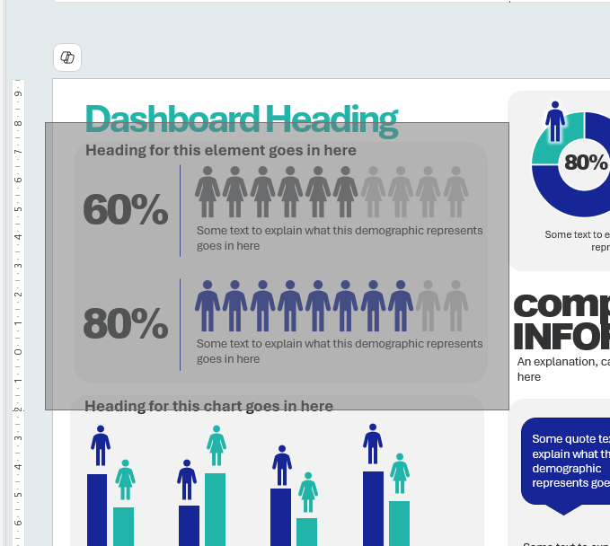

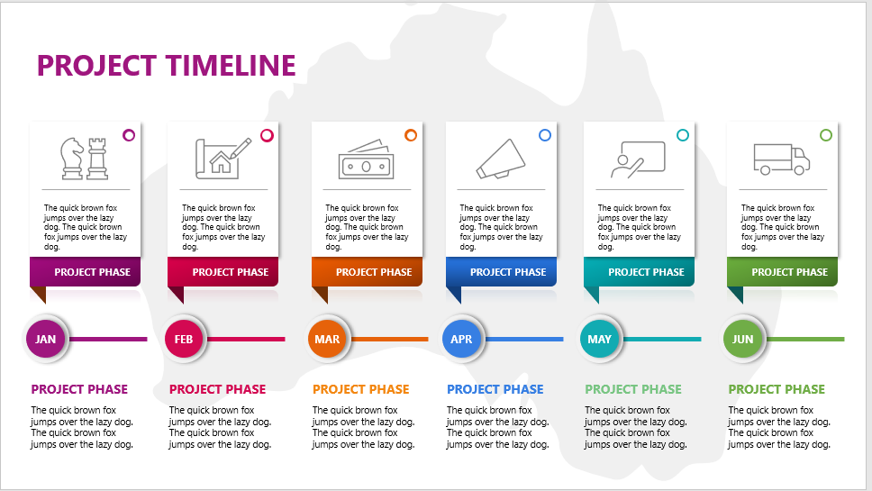
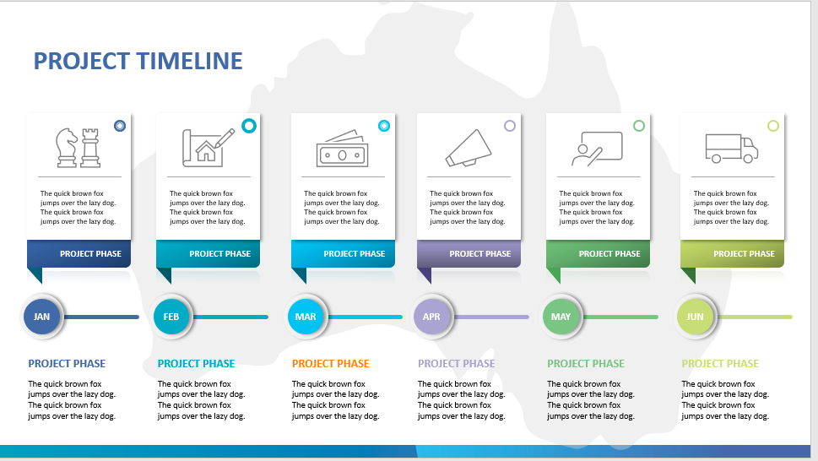
Hello. I’m Sharon Connolly, and I work with the team at ChangePlan on the product roadmap. As a Change Manager, I ensure that our software creates great solutions for your change delivery challenges. That includes ensuring that you can output data from ChangePlan beautifully.
Here’s how to get this good stuff into your corporate brand.
Copy and paste any slide directly into your corporate presentation pack, and the colours should adjust to your corporate template, or apply your corporate theme from the Design Ribbon.
The component parts of all slides can be reused and repurposed to different sizes. Make a section into a whole slide, or add it to an existing summary.
Here’s how.
Click and drag over the area you would like to repurpose.
Press CTRL + G to group the components.
CTRL + SHIFT + G will ungroup them.
Once all the parts are grouped press CTRL + C to copy, then past them to your desired location with CTRL + V.
If you need to re-size them, hold the CTRL key down while you drag from the corner, to keep the proportions.
HINT! When you resize objects the text doesn’t resize. With all objects selected press CTRL + SHIFT + < or CRL + SHIFT + > to resize all the text.
Love this? Visit www.changesuperhero.com.au and get more free downloads and sign up for the tech tips and tricks to improve your delivery skills.

