Slide 1



LANCE POWER
POWER UP YOUR WORLD
X
www.lance-power.com
Info@lance-power.com
+44 3332224368

Slide 2
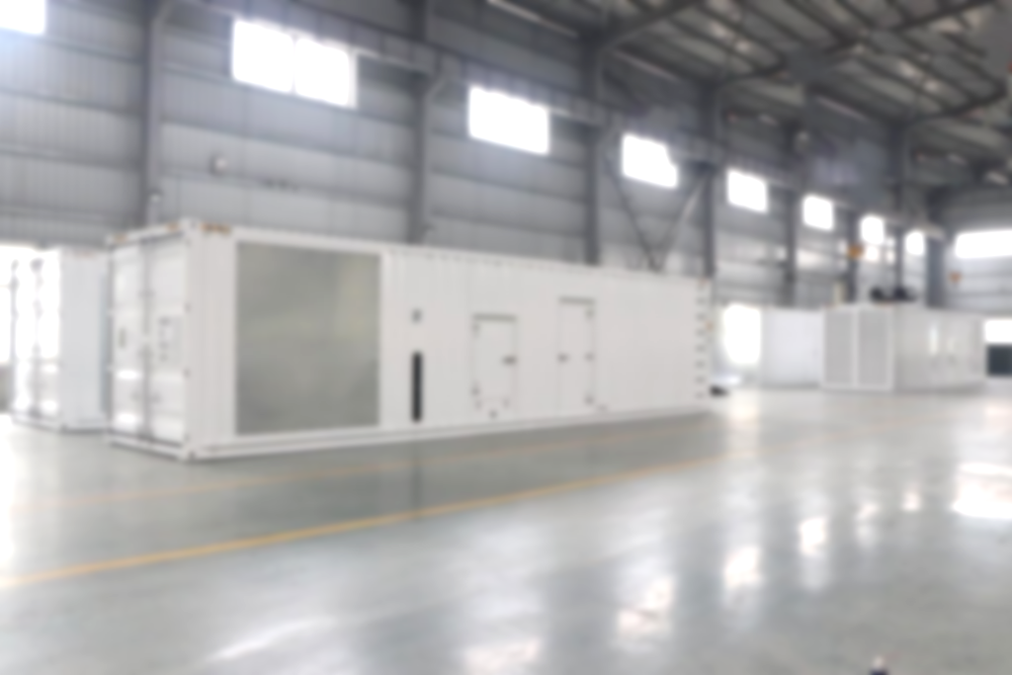

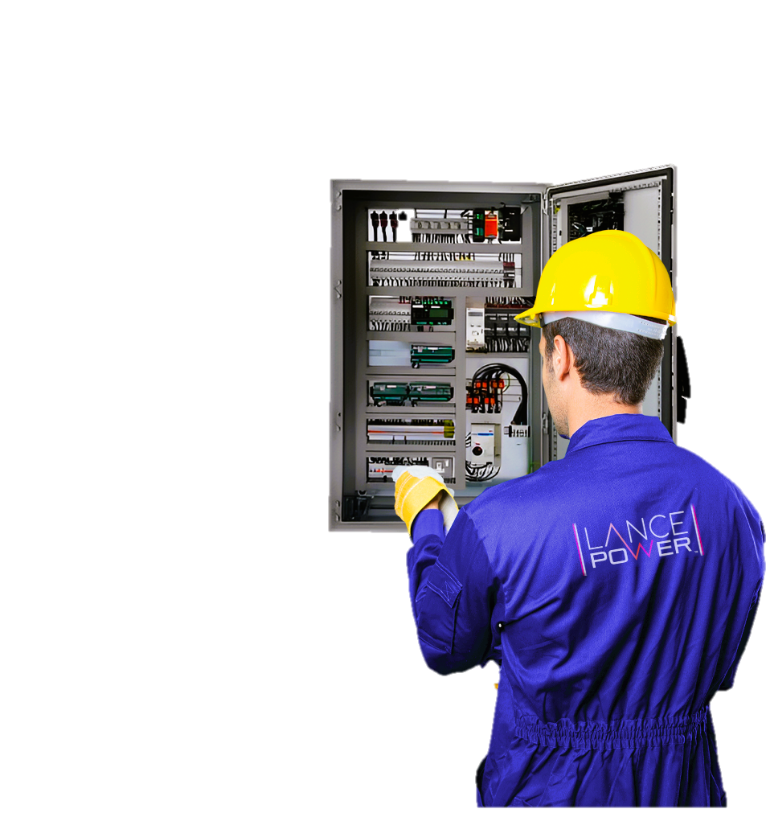
About US
At Lance Power, we deliver top-quality industrial power solutions worldwide. From consultation to installation, our team ensures your satisfaction every step of the way.
With our expertise in diesel and gas generators, switchgear, ATS, and exceptional service, we meet your unique requirements by providing the excellence of Lance Power’s reliable and bespoke power solutions.
Choose Lance Power for your prime and backup power generation needs.
2

Slide 3

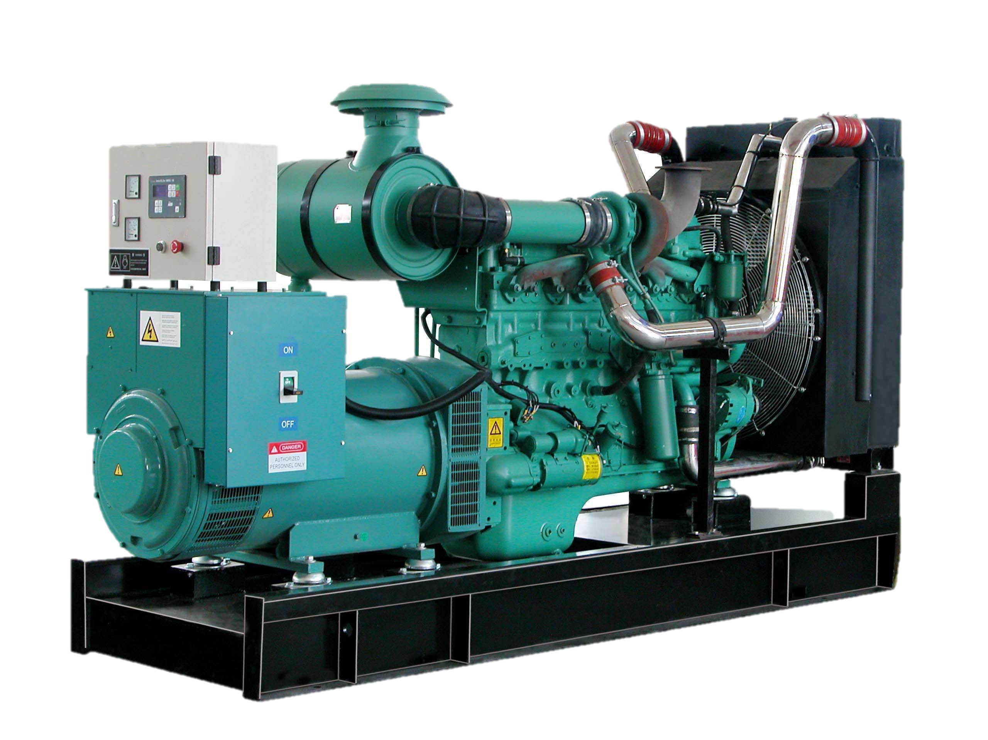


What we do
At Lance Power, we are your trusted partner for all your power generation needs.
Our team of experts is here to guide you every step of the way, ensuring that you receive the perfect equipment for your specific application.
We take pride in delivering high-quality solutions that undergo thorough testing, commissioning, and are backed by comprehensive after-sales service, including 24/7 emergency call-out cover.
Our after-sales support includes servicing, warranty claims, load banking, and round-the-clock guidance, ensuring your peace of mind.
With Lance Power, you can trust our commitment to excellence and personalised support, providing you with peace of mind and the assurance that your power needs are met with precision.
3
Notes:
You can add logo please.

Slide 4
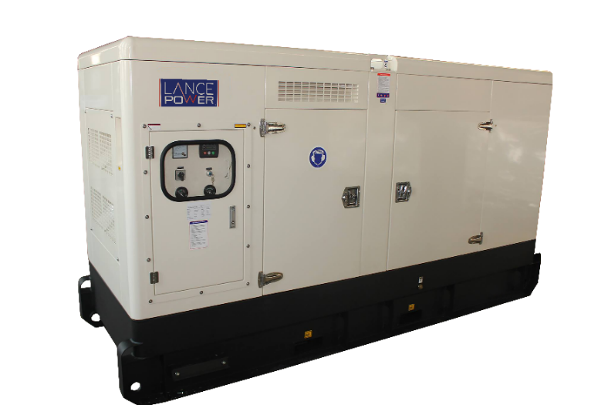
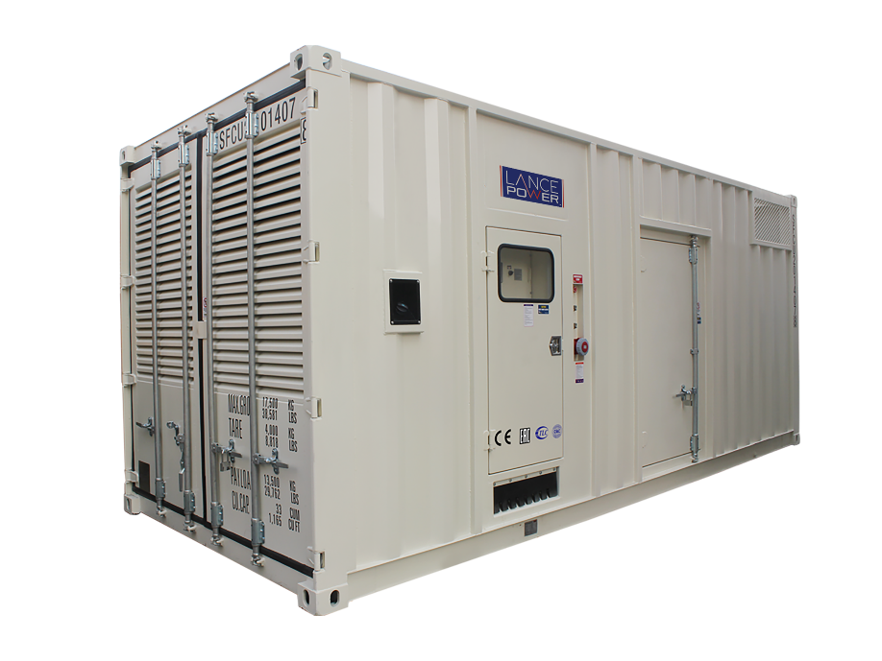
Diesel Generators
Soundproof Gensets
Superior Noise Reduction: Engineered to reduce noise levels up to 65 dB @ 1m maximum, to help control noise pollution.
Enhanced Security: Safeguarded against damages and theft by choosing optional 24/7 remote monitoring system protecting your investment.
Weatherproof Design: Built to withstand diverse weather conditions, ensuring consistent performance.
Easy Maintenance: Easy accessibility and hassle-free servicing.
Power Range: Ranging from 9 kVA to 2500 kVA,
4

Slide 5
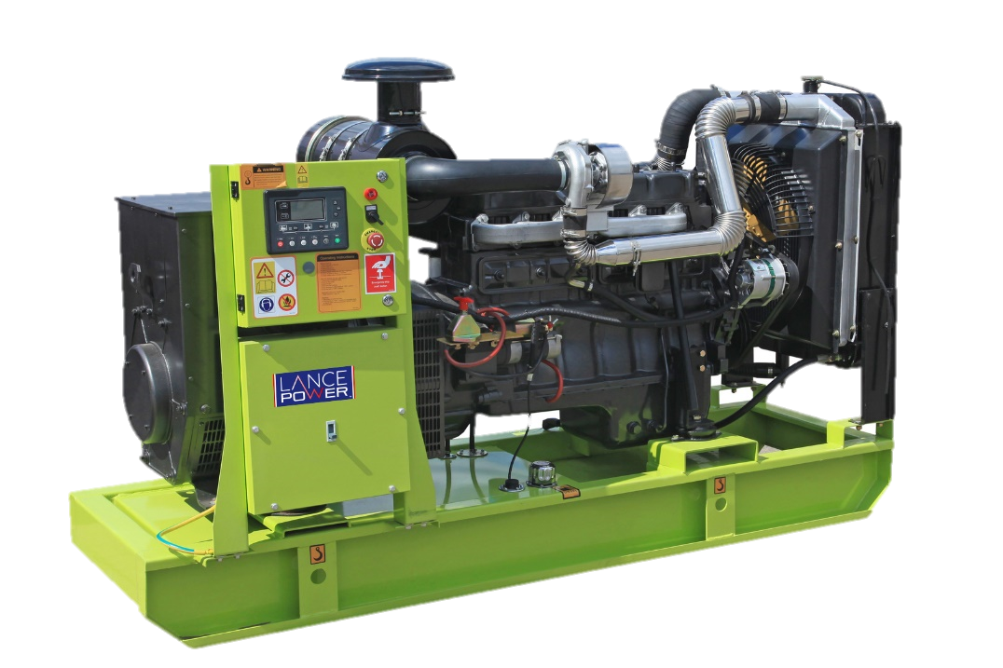
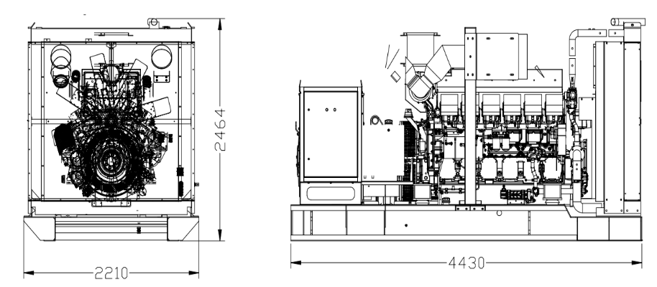
Diesel Generators
Open Gensets
Robustness & Stability: Crafted with strength, ensuring durability.
Versatility: Tailored to diverse applications, providing flexibility.
Noise Reduction: Bespoke design with specially designed mufflers.
Great Value: Delivering Value for Money.
Power Range: Ranging from 9 kVA to 2500 kVA
5
Notes:
You can do the same thing you did with the previous page

Slide 6
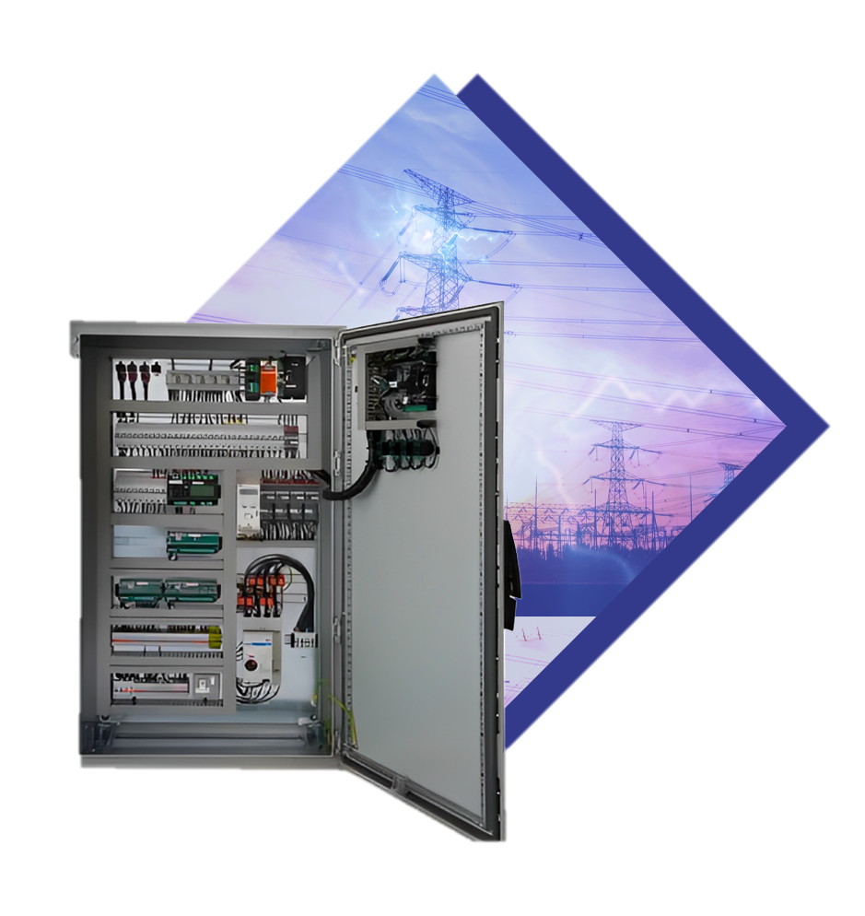
ATS & Switch Gear
We offer a range of electrical panel solutions, including but not limited to automatic start diesel generator control panels, automatic transfer switch panels, bypass switch panels, and synchronised multi-set system panels (Gen – Gen; Gen – Mains)
Lance Power's ATS panels are available in a range of sizes, from 25 to 4000 amps, and are suitable for applications where a secondary backup source of emergency power is required or grid synchronisation with G100 Protocol.
All panels are UK-built to a high BS standard and can be installed by Lance Power's team of engineers
.
6
Notes:
You can add logo please.

Slide 7

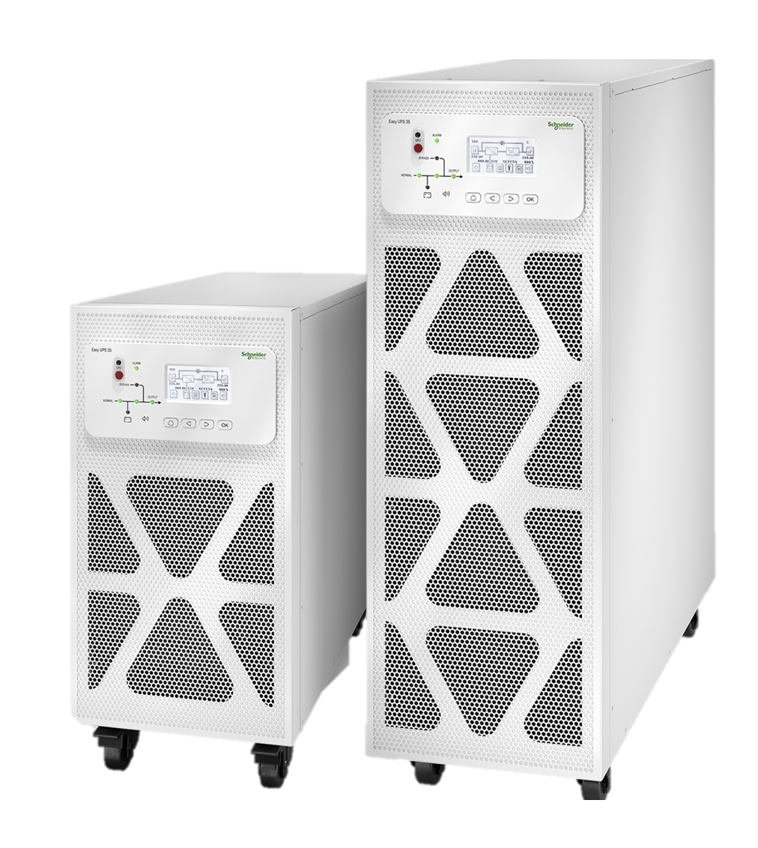
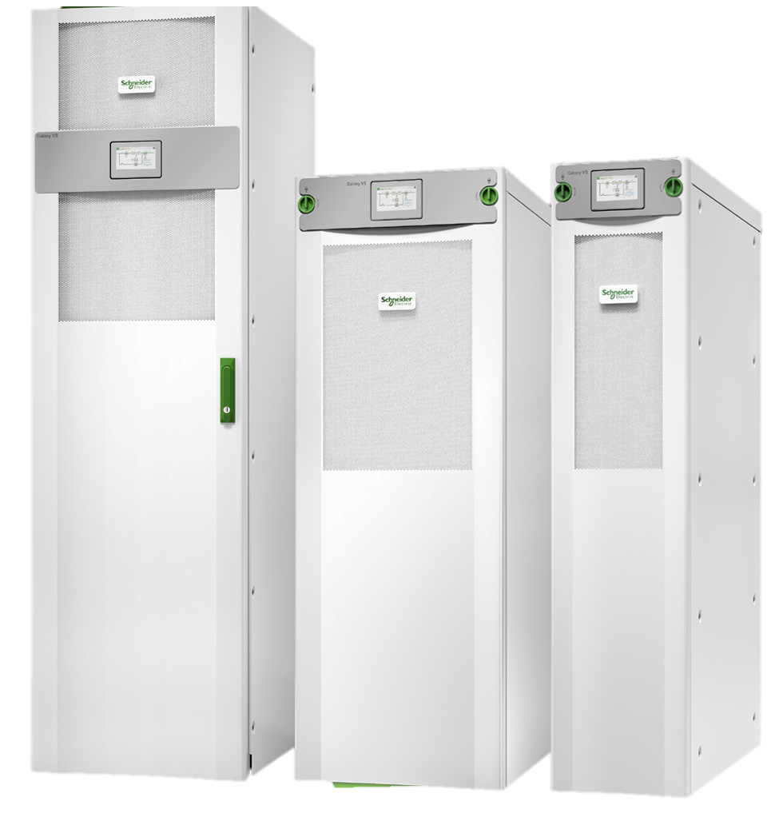

Schneider UPS
We offer a range of Schneider Uninterruptible Power Supplies (UPS)
Schneider Easy UPS Range 3S for External Batteries
10-40 kVA 400 V and 10-20 Kva 208 V3:3
Schneider Galaxy VS UPS Range
10–150 kW 380/400/415 V
Increased availability. Reduced operating costs. First-class power protection for critical infrastructure.
7
Notes:
You can add logo please.

Slide 8
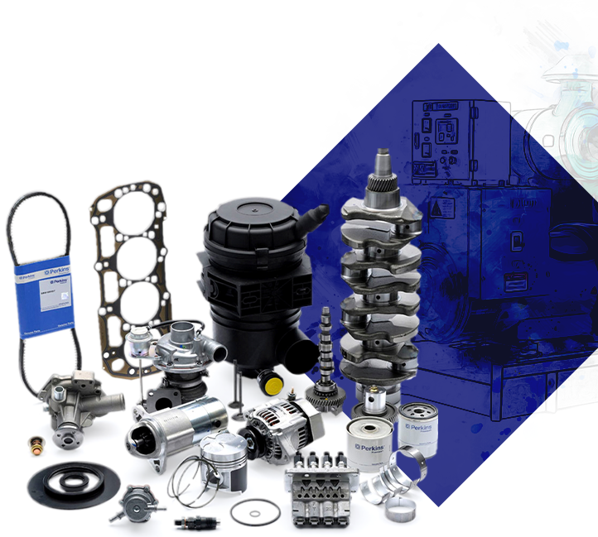
Service & Maintenance Parts
As a genuine generator parts supplier in the UK, Lance Power offers a wide range of services for the repair and replacement of parts, including full-service kits that contain all the necessary components for a complete service
You only have to provide the part number and engine number when you contact Lance Power, and their parts team will be happy to assist you in locating the right part for you.
With Lance Power, you can be assured of high-quality and reliable spare parts for your generators.
9

Slide 9













Some of Our Trusted Suppliers
We collaborate only with trusted suppliers who share our commitment to quality, reliability, and long-term performance
9

Slide 10





Our Process
Consultation and Requirements Gathering:
Design and Planning:
Equipment Supply and Installation:
Testing and Commissioning:
Ongoing Support and Maintenance:
We engage in thorough discussions with you to understand your specific power generation needs and requirements, ensuring a tailored solution.
Our experienced team creates comprehensive designs and plans, considering factors such as load capacity, fuel efficiency, and site conditions.
We source high-quality equipment and components from reputable manufacturers and handle the seamless installation process, ensuring everything is properly integrated.
We conduct rigorous testing and commissioning procedures to ensure that your power generation system operates efficiently and reliably.
We provide continuous support and maintenance services to ensure long-term performance and reliability, including regular inspections and prompt troubleshooting.

Slide 11




Tender.
Market Sectors We Serve
Industrial
We cater to various industries such as manufacturing, construction, data centers, telecommunications, oil and gas, and agriculture, providing reliable power solutions to meet their specific operational requirements.
Industrial
Public Sector (NHS Trusts, Government/Military):
We serve public sector entities including NHS trusts, government agencies, and military organizations, ensuring uninterrupted power supply for critical infrastructure, healthcare facilities, and emergency services.
Public Sector
Private Sector
We partner with private sector businesses across different industries, offering customized power solutions for commercial properties, hospitality establishments, retail outlets, and other private enterprises.
Private Sector
Residential
We provide residential power solutions, delivering backup and prime-power generators for homes and residential complexes, ensuring comfort, security, and uninterrupted power supply during outages.
Residential

Slide 12


Benefits of Choosing Lance Power
Reliability you can trust
Customised solutions for your unique requirements
We deliver high-quality products and services that meet your power needs effectively and efficiently.
We understand that each customer has specific needs, and we tailor our solutions to meet your individual demands.
Expertise across top brands
Our team possesses extensive knowledge and experience with multiple leading generator brands, providing you with expert advice and support
Peace of mind through ongoing maintenance
We offer comprehensive maintenance services to keep your power system operating at its best, providing peace of mind.
Quality components for lasting performance
We source the finest parts and components from leading manufacturers to ensure durability and optimal performance.
Responsive real-time support
Our dedicated team provides prompt and reliable support, offering real-time assistance whenever you need it, 24/7.
Seamless integration and compatibility
Enhanced cost-effectiveness
We ensure that our power solutions seamlessly integrate with your existing systems, minimising disruptions and maximising compatibility
With our high-quality products and efficient solutions, you benefit from cost-effectiveness in the long run, optimising your investment.

Slide 13


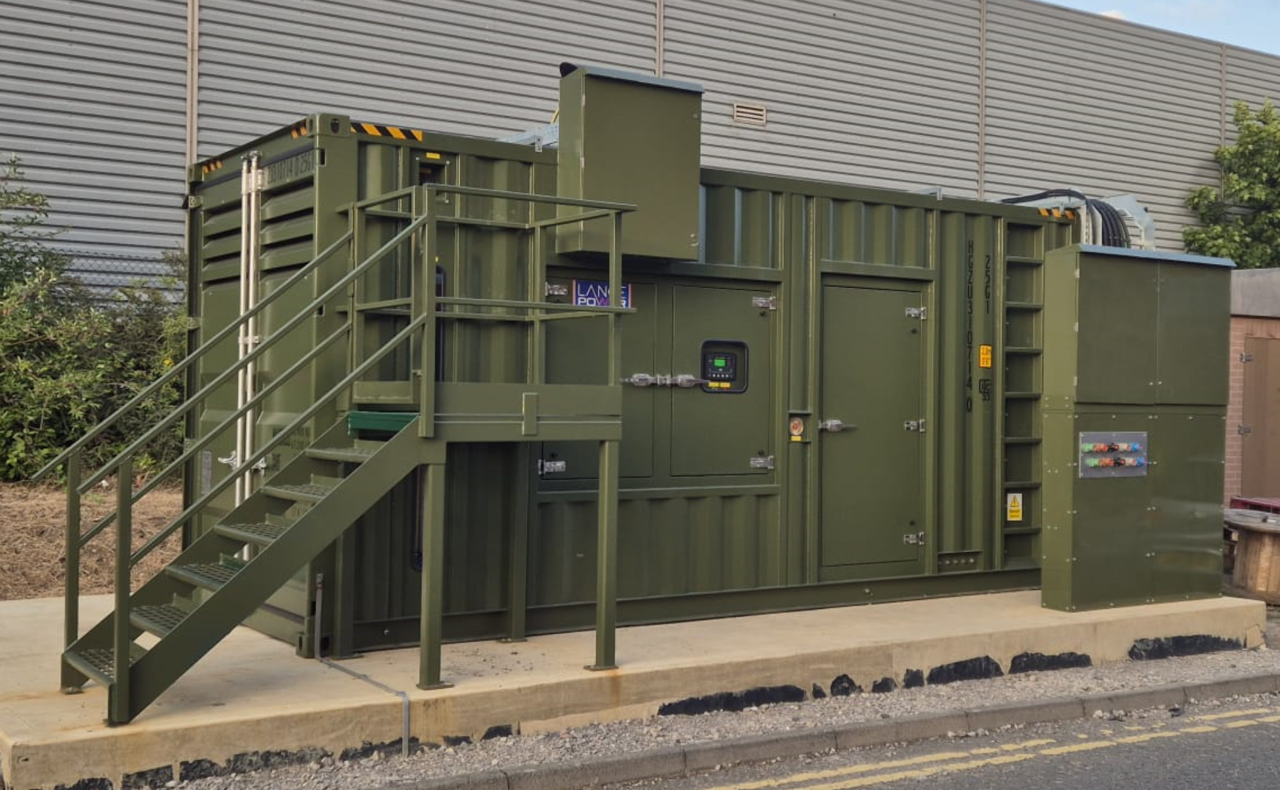
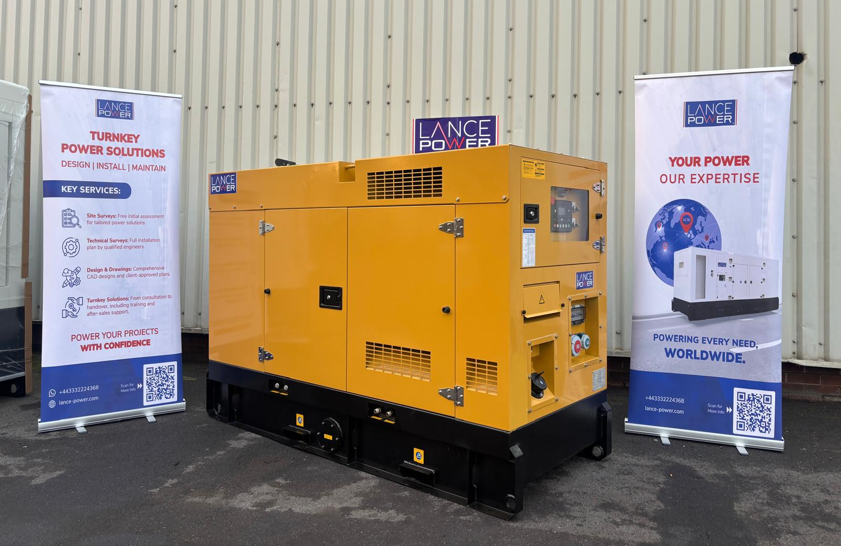
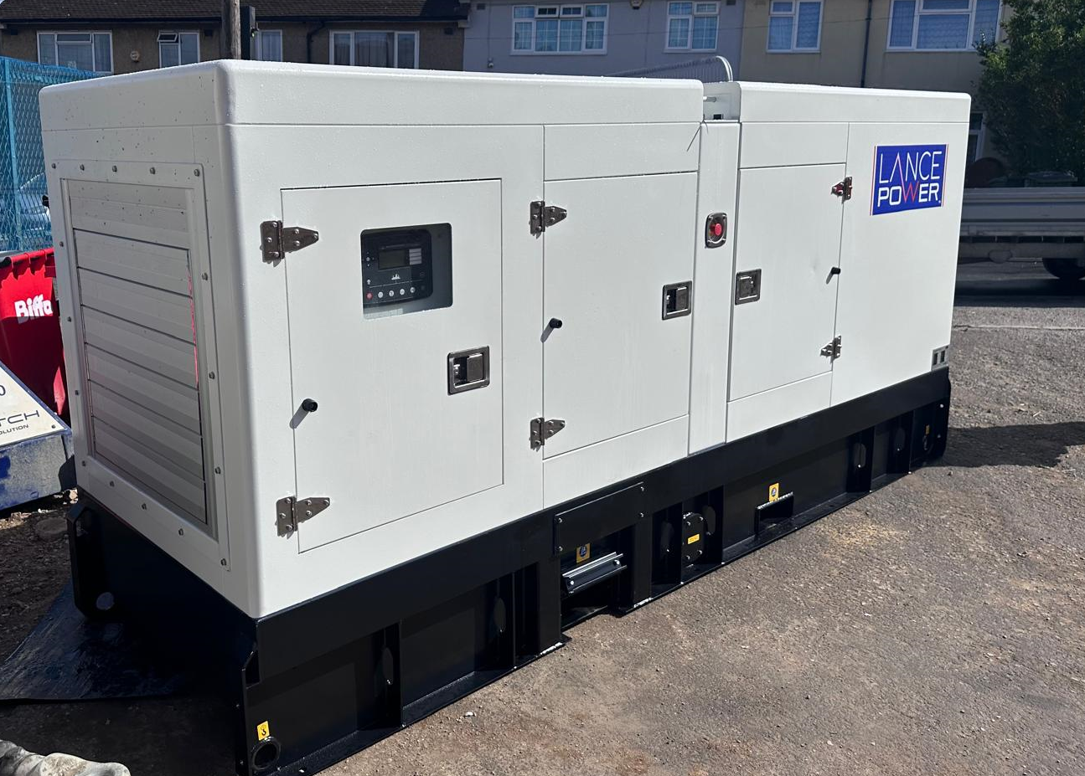
Our Collaboration with YESSS so far
From large-scale industrial installations to bespoke off-grid systems, our joint portfolio highlights just how versatile and effective our collaboration has become. We are proud to be featured on the new YESSS Industrial Switchgear Solutions Catalogue.
Key projects delivered with YESSS so far include:
Trafford Park – 80 kVA Generator
Installed for a London school, ensuring dependable backup power for essential services.
Project value: £33,000
Nottingham – 1000 kVA Generator
Powering a major food production facility with a high-capacity, fully integrated solution.
Project value: £175,000
Isle of Man – 40 kVA Off-Grid System
A collaborative project with YESSS Renewables, currently in progress.
Project value: £15,000

Slide 14


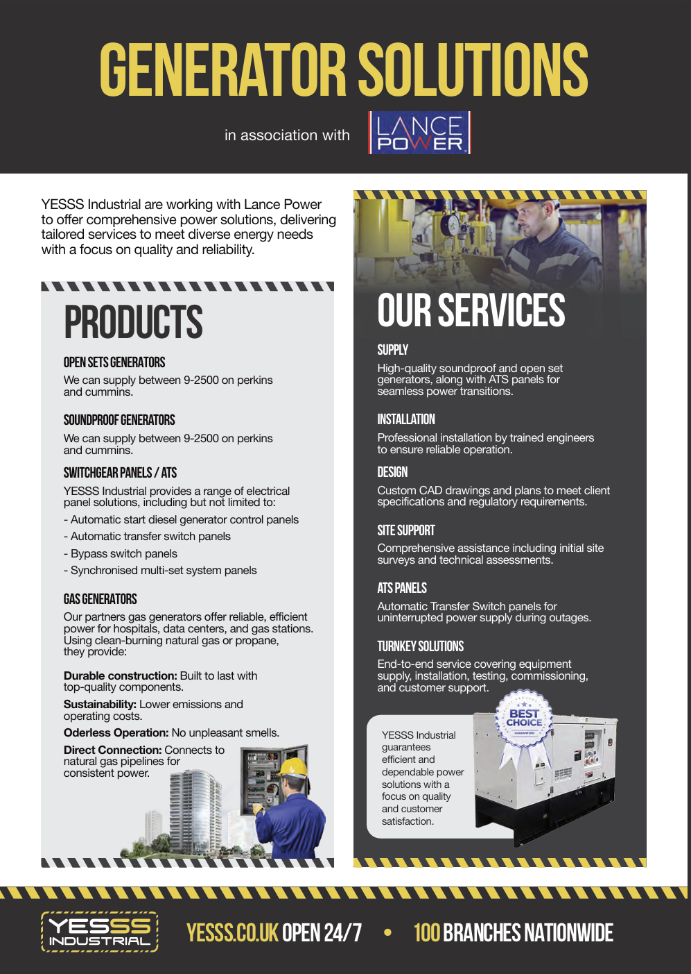
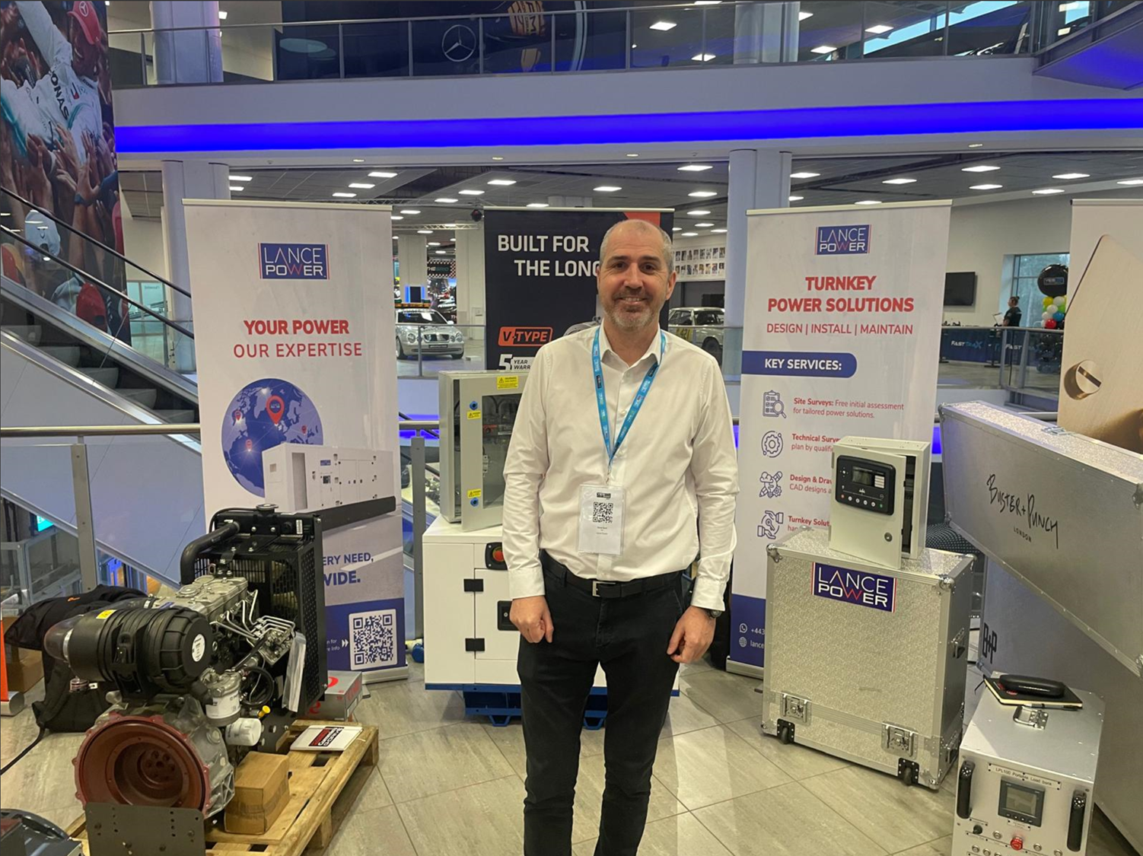
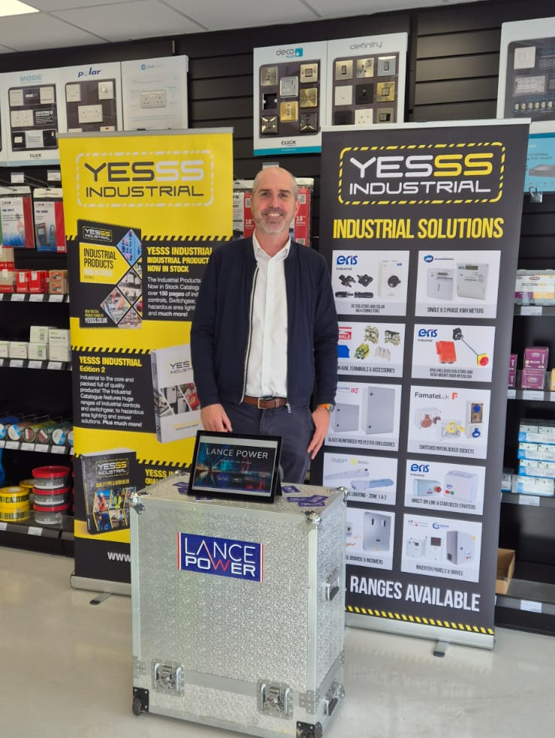
Our Collaboration with YESSS so far
Trafford Park – 3 × 80 kVA Generators
Supporting Highways England motorway depots with reliable standby power.
Project value: £48,000
Tunbridge Wells – 500 kVA Generator
Delivered to a factory requiring robust standby support.
Project value: £49,000
Tunbridge Wells – 200 kVA Generator
Installed for a water treatment plant, enhancing operational continuity.
Project value: £25,000
Coventry (via YESS Projects Team) – 250 kVA Generator
A major installation for the National Grid—currently in progress.
Project value: £147,000
Dundee – 20 kVA Off-Grid System
Supporting a farm with a compact, efficient off-grid power solution.
Project value: £22,000
Tyne Tunnel – 26 kVA Generator
Delivered for a security firm operating within the tunnel infrastructure.
Project value: £20,000

Slide 15


ISO Certificates and
The Armed Forces Covenant
15
Notes:
Can you please show me another design, and also please keep in mind that ISO certificate are the same, it’s only the color is different.

Slide 16

Contact Us.
OFFICE HOURS
FOLLOW US
GET IN TOUCH
OUR ADDRESS
Instagram: lancepowergenerators
Facebook: lancepowergenerators
Linkedin: lancepowergenerators
Monday – Friday
8.30 AM – 5.00 PM
lancepower.com
info@lancepower.com
+443332224368
Lance Power, Unit C3 Vivars Way, Selby, North Yorkshire, YO8 8BE

Slide 17


THANK YOU
Any Questions?

