Slide 1

COMMITTAL PROCEDURE: SETTING THE STAGE FOR SUCCESS
Part 1 – Committal Essentials Series
IAN HILL KC
Barrister
Gorman Chambers
MITCH BROGDEN
Barrister
Castan Chambers
BRYONY SEIGNIOR
Barrister
Koiki Mabo Chambers
September 2024

Slide 2
Overview
Purpose and overview of committal proceedings
Overview of the Criminal Procedure Act 2009 and the Magistrates’ Court Criminal Procedure Rules 2019
Preliminary Hearings
  Filing Hearing
  Committal Mentions
  Committal Case Conference
  Special Mentions
Leave to cross-examine and protected witnesses
Case Direction Notice (Form 32)
Managing Disclosure
Common issues from perspective of the Magistrates’ Court

Slide 3
Introduction
There has been long-standing debate in all common law jurisdictions about the role, value, costs and benefits of committal proceedings in modern criminal justice systems.
In 2018, wide-ranging changes were implemented in New South Wales, which amongst other things, removed the requirement for a Magistrate to make a decision about the sufficiency of evidence before committal.
In 2020, the Victorian Law Reform Commission recommended substantial reforms to the Victorian Committal process. It recommended the committal test be abolished.
This has not yet occurred, but the space is one to continue watching.

Slide 4
Purpose and overview of committal proceedings
‘Committal proceedings’ are a species of pre-trial procedure.
Judicial check on the executive arm of government.
The main function of committal proceedings, is to determine whether the evidence is of sufficient weight to support a conviction (s 141).
Purposes are broader (s 97 CPA), and include to:
  Determine whether summary jurisdiction is appropriate;
  Determine whether there is evidence of a sufficient weight to support a conviction;
  Determine whether resolution is possible;
  Ensure a fair trial, if the matter proceeds to trial (for example by enabling: sufficient disclosure, the accused to be aware of the evidence against them, or the issues in contention to be adequately defined).

Slide 5
When will a committal hearing be held?
Must be held in all cases in which the accused is charged with an indictable offence, except:
  Where a direct indictment is filed; or
  The charge is heard and determined summarily (s 96 CPA).
The Magistrates’ Court will also list the matter for a filing hearing where the Informant requests a committal proceeding for an indictable offence that is triable summarily (ss 6, 10 CPA).
This means all criminal cases in Victoria start in the Magistrates’ Court, except where the DPP files a direct indictment in the County Court or the Supreme Court.

Slide 6
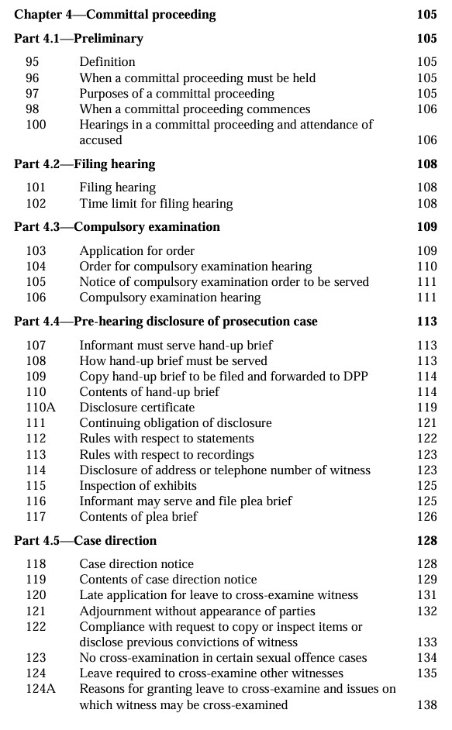
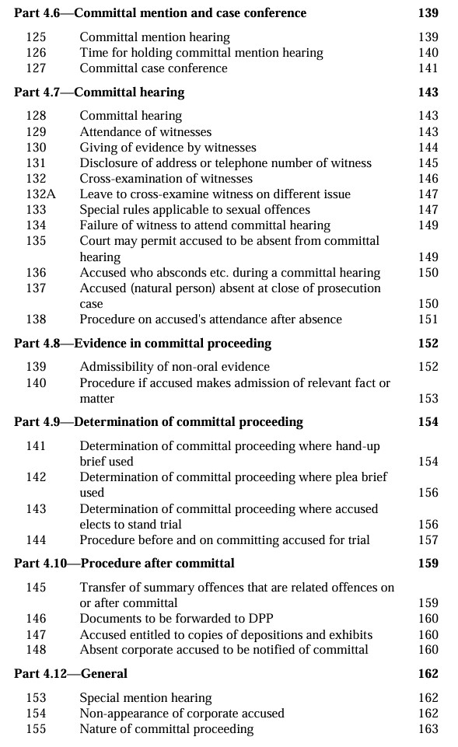

Criminal Procedure Act 2009
Sections 95 – 157 set out the procedure.
Section 100 provides that the hearings in a committal proceeding are:
  A filing hearing
  A special mention hearing
  A compulsory examination hearing
  A committal mention hearing
  A committal case conference
  A committal hearing (subject to s 123)

Slide 7
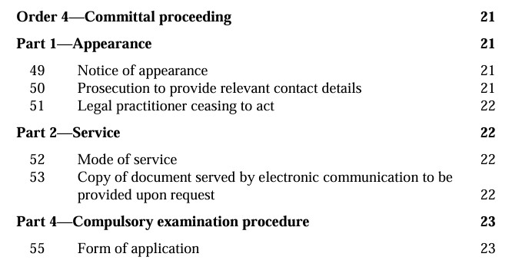
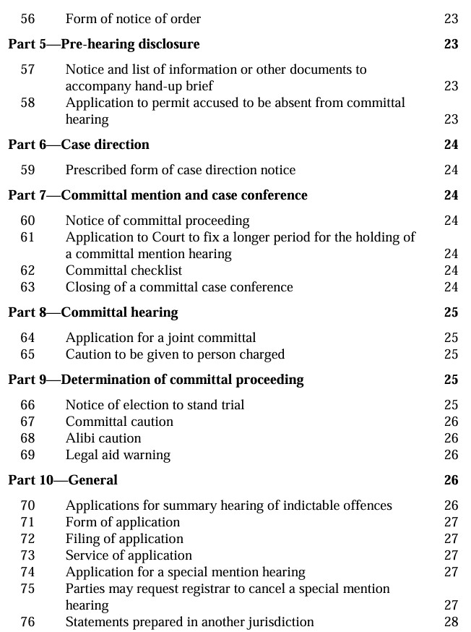
Magistrates’ Court Criminal Procedure Rules 2019
Order 4 includes:
  Notice of appearance / ceasing to act
  Compulsory examination procedure
  Prescribed form of a case direction notice
  Committal checklist
  Caution to be given
  Application for a joint committal
  Notice of election to stand trial without a committal proceeding
  Committal caution / alibi caution
  Application for special mention

Slide 8
Overview of committal proceeding
Part 4.2
Filing Hearing
Part 4.4
HUB Service
Part 4.5
Case Direction Notice
Part 4.6
Committal Mention
Part 4.9
Determination of Committal Proceeding

Slide 9
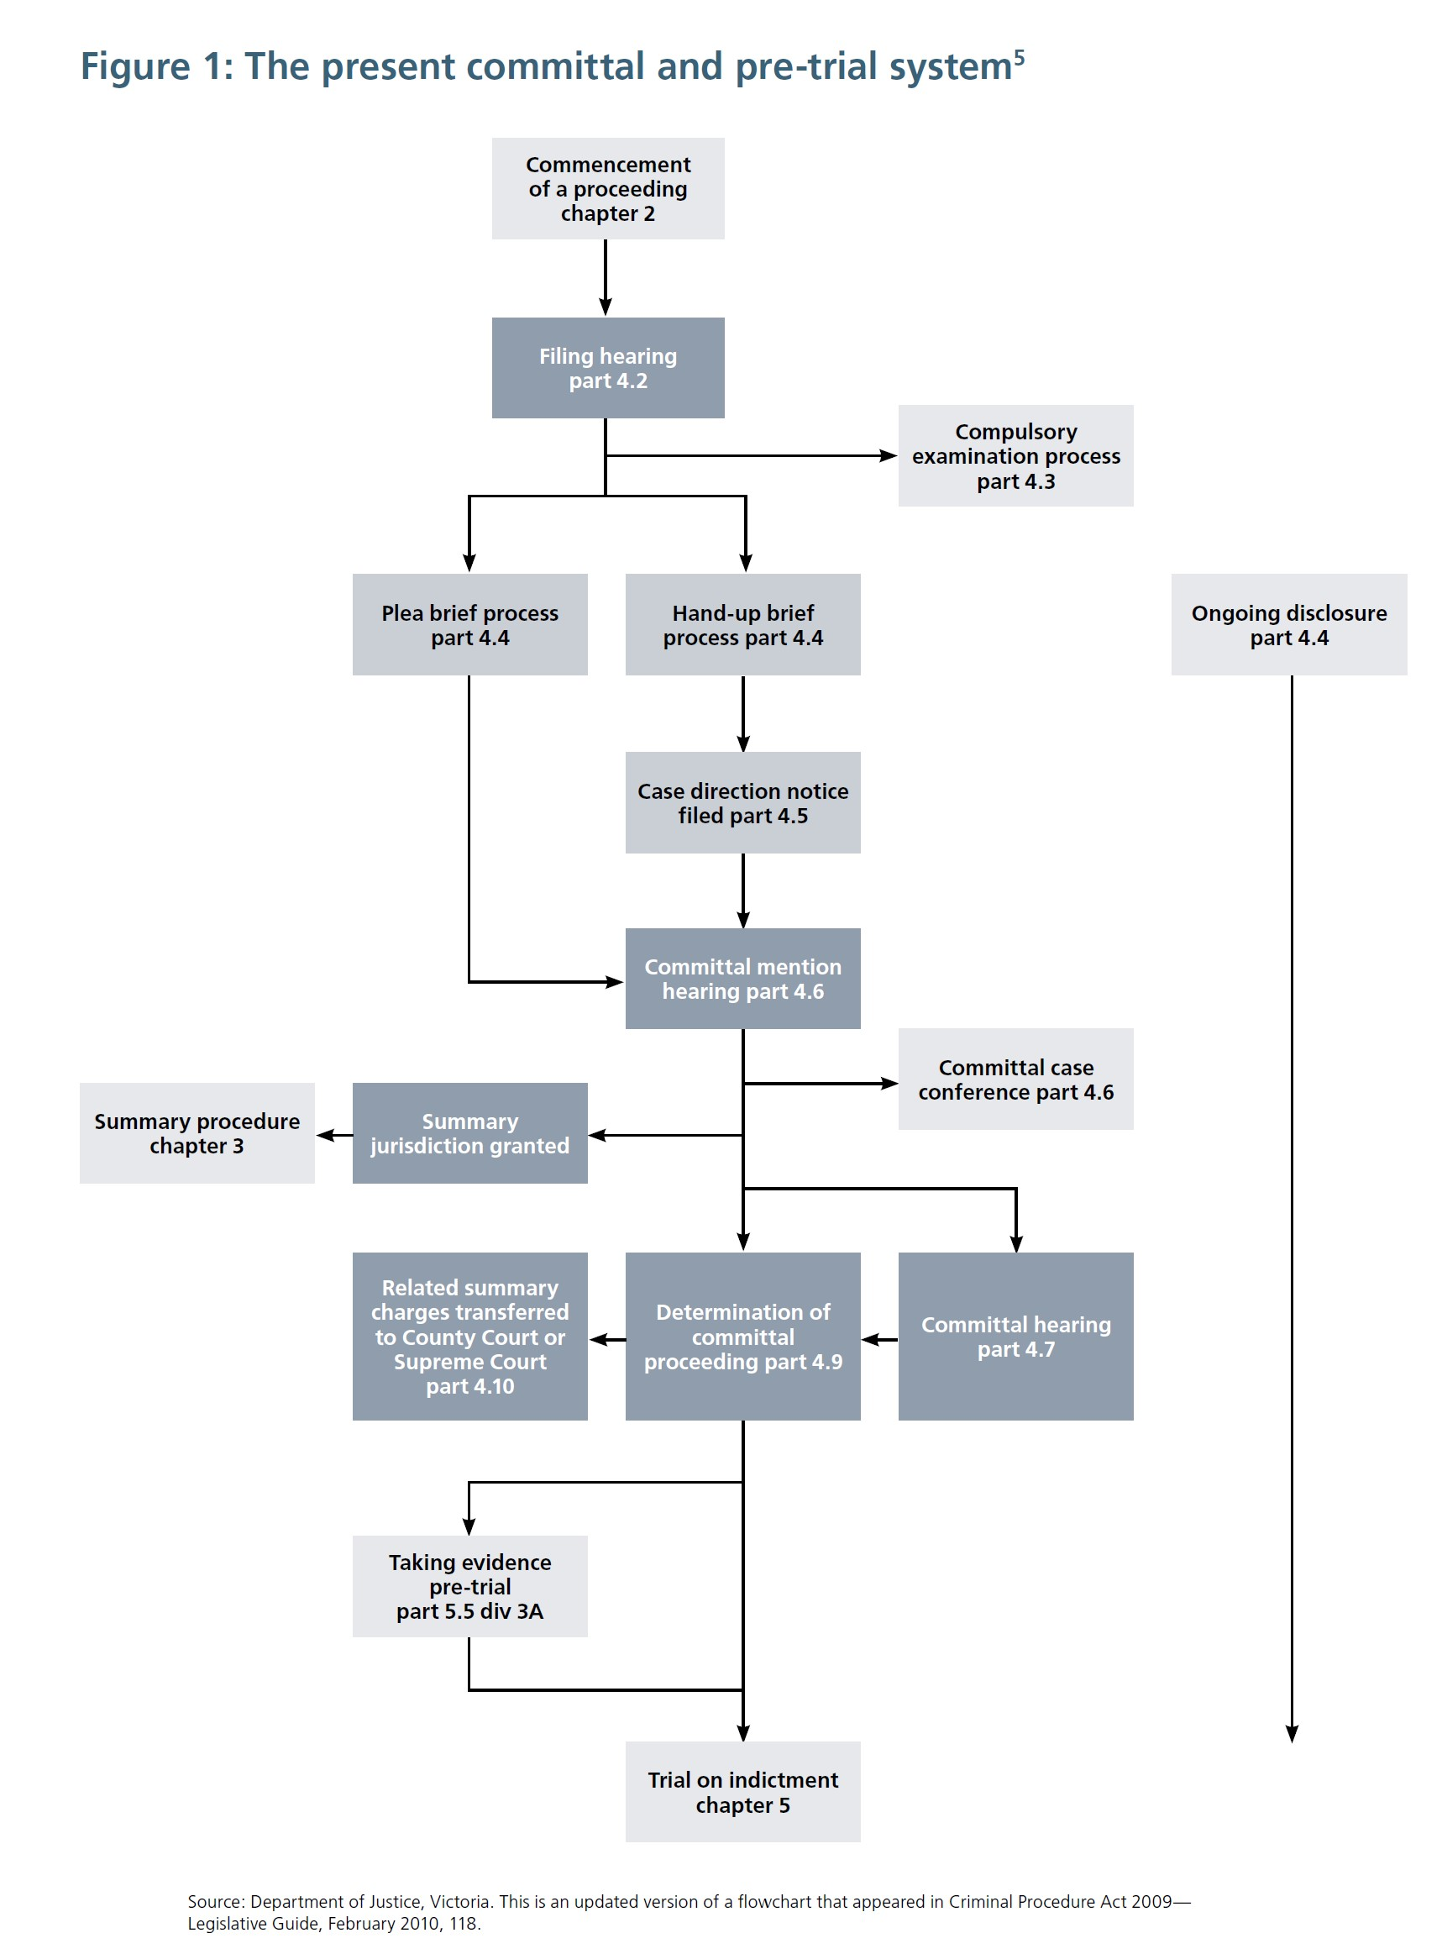
Diagram extracted from the VLRC Committals Report March 2020: https://www.lawreform.vic.gov.au/project/committals/

Slide 10
Filing Hearing (ss 101, 102)
A criminal proceeding is commenced in accordance with s 6 CPA.
A committal proceeding commences with a filing hearing (s 98).
Section 102 provides for the fixing of a date for a filing hearing.
  The date fixed for a filing hearing must be (a) within 7 days of the charge sheet being filed if the accused is in custody or on bail, or within 28 days if a summons is issued
Practically the filing hearing is usually held at the time the accused is brought before the court for the remand hearing – so within 24 hours.
Purpose (s 101): The Magistrate sets dates for the service of the hand-up brief (HUB) and fixes the date for the committal mention (and makes any other orders required).

Slide 11
Pre-hearing disclosure
When served with a summons or when a warrant to arrest is executed on the accused, the accused must be given a copy of the charge sheet, details of when the matter is listed to be heard, and a Form 9 Notice (Magistrates Court Criminal Procedure Rules).
In a committal proceeding, the accused is also entitled to receive a:
  Hand-up Brief; or
  Plea Brief.
The Informant may serve a plea brief if the accused gives written consent to receive a plea brief (this procedure is rarely used). Ongoing disclosure obligations only apply to hand-up briefs and do not apply to plea briefs (s 111).

Slide 12
Managing Disclosure
Full and timely disclosure is essential to both parties.
Delays in disclosure can undermine your ability to prepare effectively, can cause delays and adjournments.
The hand-up brief should contain all the evidence, including statements, exhibits, and any other material the prosecution intends to rely on.
The prosecution has ongoing obligations to disclose new material that arises.
However, defence must be vigilant in identifying gaps in the HUB, and request further disclosure where necessary.
Utilise the committal mention process and Form 32 to request disclosure from the informant/OPP and to raise any non-disclosure issues with the Magistrate.

Slide 13
Hand Up Brief (s 107)
The hand-up brief comprises the prosecution's evidence and includes materials listed under s 110 of the CPA.
The HUB must be served on the accused and their legal representatives within the timeframe established at the filing hearing, typically 42 days before the committal mention.
  If the Informant requires an extension of time and this cannot be agreed with Defence, it must be granted by the court.
Disclosure obligations continue after the HUB is served, and any further materials must be disclosed promptly s 111 of the CPA.
Timelines:
In typical cases, the HUB is due 6 weeks after the filing hearing, and the committal mention is set 6 weeks after that.
In homicide cases, HUB service is usually set for 10 weeks after filing, and in culpable driving causing death cases, it is 12 weeks.
On occasion, the HUB will already be prepared and may be served at the filing hearing (usually historic cases).

Slide 14
Committal Mention Hearing (s 125, 126 )
This is where the parties tell the court how the matter will proceed (whether the accused is pleading guilty or not guilty).
Timelines:
  Must be held within 3 months - for a sexual offence
  Must be held within 6 months – for any other offence
  However the Magistrate may fix a longer period in accordance with s 126(2)
At committal mention, the Magistrate may:
  Immediately determine the committal proceeding in accordance with ss 141, 142 or 143
  Offer a summary hearing or determine a summary jurisdiction application in accordance with s 30
  Hear and determine an application for leave to cross-examine a witness
  Fix a date for a committal hearing
  Hear and determine any objection to disclosure of material
  Fix another date for a committal mention hearing
  Make any order or give any direction that the court considers otherwise

Slide 15
Committal Mention
Committal Mention
Plea of guilty
Committed to either County Court or Supreme Court of Victoria for a plea of guilty
Summary Jurisdiction Application
If granted, matter remains in Magistrates Court for plea
Plea of not guilty
Committal Hearing
Can involve XXN of witnesses if granted leave
Summary Jurisdiction Application
If granted, matter remains in the Magistrates Court for a summary contested hearing

Slide 16
Committal Hearing
At a Committal Hearing, the Magistrate considers whether to commit the accused to stand trial based on the material in the hand-up brief and any other evidence given during the hearing.
The test is found in s 141(4) and it is whether there is evidence of a sufficient weight to support a conviction for the offence with which the accused is charged. If there is, the Magistrate must commit the accused for trial. If there is not, then the Magistrate must discharge the accused, or may adjourn to enable a different charge to be filed (s 141(4)(c)):
  Following a finding there is evidence of sufficient weight to support a conviction, the Magistrate must read the committal caution and ask the accused how they plead (s 144);
  The Magistrate will also read the alibi caution if relevant;
  Upon being committed for trial, the question of bail arises anew
  Process and procedure to be outlined in further detail in Part 2 of the Committal Essentials Series

Slide 17
Other types of hearings in the committal process
A special mention hearing:
  A process for mentioning the matter for some reason, for example to raise disclosure issues or extend time for service of the HUB
A compulsory examination hearing:
  For this process to occur, the Informant must make an application to examine a person or require them to produce a document in a coercive environment.
  See s 10, 104 CPA
A committal case conference:
  This can be used in placed of a committal mention where matters may be assisted by judicial intervention.
  All discussions without prejudice
  The committal case conference occurs in closed court

Slide 18
Case Direction Notice (Form 32)
The accused and Prosecution must jointly file a Case Direction Notice at least 7 days before the committal mention hearing.
Section 119 governs the content of a case direction notice. In summary, a Form 32 must:
  Specify the procedure by which it is proposed the matter be dealt with; and
  State the names of any witnesses that the accused intends to seek leave to cross-examine and identify:
    Each issue for which leave to cross-examine is sought; and
    The reason why the evidence of the witness is relevant to the issue; and
    The reason why cross-examination of the witness on the issue is justified.
Discuss with counsel prior to filing any Form 32.

Slide 19
Leave to cross-examine
Section 124 outlines the considerations that a Magistrate will take into account in determining whether to grant leave to cross-examine a witness at committal.
Key considerations:
  Whether the informant (generally the OPP) consents to or opposes leave being granted;
  The accused has satisfied the court of a relevant issue that justifies cross-examination at committal;
  The court must also have regard to the need to ensure that:
    The prosecution case is adequately disclosed;
    The issues are adequately defined;
    The evidence is of sufficient weight to support a conviction;
    A fair trial will take place if the matter proceeds to trial, including that the accused is able to adequately prepare and present a defence;
    Matters relevant to a potential plea of guilty are clarified;
    Matters relevant to a potential discontinuance are clarified;
    Trivial, vexatious or oppressive cross-examination is not permitted; and
    The interests of justice are otherwise served.
  There are additional considerations under subsection (5) for a witness who is a child, cognitively impaired or a complainant in relation to a charge for a sexual offence or family violence.

Slide 20
Common issue topics
Credibility and reliability (prior convictions, intoxication of witness, memory etc.)
An element of the offence (identity, intention, assault, type of injury, possession, knowledge, entry, weapons, consent, reasonable belief in age etc.)
Quality of the investigation (Caution & rights, arrest power, warrants, continuity of exhibits, making of statements etc.)
Observations (opportunity, obstructions etc.)
Admissibility of evidence (ROI, search powers, seizure of exhibits, expert evidence, admissions, ICE etc.)
Inconsistent statements
Nature and extent of relationship with accused (if relevant)
Nature and extent of the allegations (time, date, location, missing key details etc.)
Complicity (role of the accused, involvement etc.)
Relevant defences (self-defence, mental impairment)
Complaint evidence
Factual dispute

Slide 21
Bad Form 32
Name of witness | Does the Informant oppose leave being granted? | Issue, relevance, justification | Opposition
D/S/C Smith | No | Issue: This witness is the informant. Relevance: This witness conducted the entire investigation and was responsible for laying the charges. Justification: Cross-examination is sought in respect of the issues outlined above and is justified on the basis that they are matters central to the defence.

Slide 22
Better Form 32
Name of witness | Opposition? | Issue, relevance, justification
Linda Brooks (HUB, pp 59-69) | Not opposed | Issues: This witness is the complainant and gives direct evidence of the alleged incidents. The credibility and reliability of this witness are fundamental issues in this matter. Cross-examination is sought with respect to: The background, context and nature of her relationship with the accused; The timing of the alleged incidents; The nature and extent of the allegations; This witnesses account of the surrounding circumstances in respect of the incident, including her interactions with the accused before, during and after the incident; The accused's role in the incident; The particulars and circumstances of her alleged complaint to witness Jo Smith Relevance: Cross-examination of this witness is relevant, in that: Proof of the charges depends essentially upon the evidence of this witness; The allegations are factually disputed; and This witness's credibility and reliability are fundamental issues in the case Justification: Cross-examination on the above issues is justified because it will: Ensure a fair trial, including to ensure that the accused can adequately prepare and present his defence; Ensure the issues in the case are adequately defined; Ensure the case against the accused is adequately disclosed; and Test whether the evidence is of sufficient weight to support a conviction for the offence.

Slide 23
Magistrates’ common frustrations with Form 32's
Late filing of Form 32
Read the brief
Tailor the Form 32 to your case – don't copy and paste
Applications for leave to XXN lacking detail or too broad
Be aware of the test the Magistrate must apply under s124 – your justification should satisfy at least one of those limbs
Specify why an adjournment is required if the case cannot progress

Slide 24
Protected Witnesses
Section 123 deals with certain witnesses that cannot be cross-examined at committal.
Any witness in a criminal proceeding wholly or partly relating to sexual offences involving a complainant who is a child or is cognitively impaired.
These matters will generally proceed by way of "Straight Hand-up-brief" to the higher courts where any pre-trial cross-examination of a witness (other than the complainant) can be applied for under s198A.

Slide 25
Managing Client Expectations and Strategy
It is important to conference your client before any committal hearing so that they understand the nature of the hearing and are realistic about the possible outcomes.
For cases where discharge is unlikely, advise the client that the purpose of the committal is to set up the case for trial by:
  Locking witnesses into versions which can later be challenged in front of a jury
  Exploring the extent to which a witness may be consistent with the accused's instructions (but not challenging them yet)
  Exploring issues relating to the admissibility of evidence
  Obtaining any concessions which might assist in future resolution discussions
  Only 5% (approximately) of accused are fully discharged at committal.

Slide 26
Conclusion
Review the Hand Up Brief as early as possible.
Discuss the case with trial/committal counsel as early as possible.
Make sure the Form 32 is tailored to the facts and issues of the specific case.
Manage client expectations throughout the process.

Slide 27

Questions?
Please feel free to send any additional questions to Mitch or Bryony directly.
Mitch Brogden: Mitch Brogden - Barrister (greenslist.com.au)
Bryony Seignior: Bryony Seignior - Barrister (greenslist.com.au)

Slide 28

Part 2: Committals – Tips and Techniques
Justin Hannebery KC
Deanna Caruso
Bryony Seignior
23 October 2024
1:00 PM – 2:00 PM
This session delves into the complexities of contested committals, with a particular focus on defence perspectives.
Key topics include effective preparation strategies, techniques for cross-examination, understanding and applying the committal test, navigating discharge applications, committal for trial and subsequent events.

